Slide 1
Build and maintain high performance SQL Servers
Justin Randall SQL Sentry, Director of Professional Services jrandall@sqlsentry.com
@jh_randall
Notes:
25 years of IT experience, 15 as a DBA
You can find similar discussions/presentations on the web, usually referred to as Health Checks.

Slide 2
Agenda
Power Management
Compute Resources & Performance
TempDB
Virtualization

Slide 3
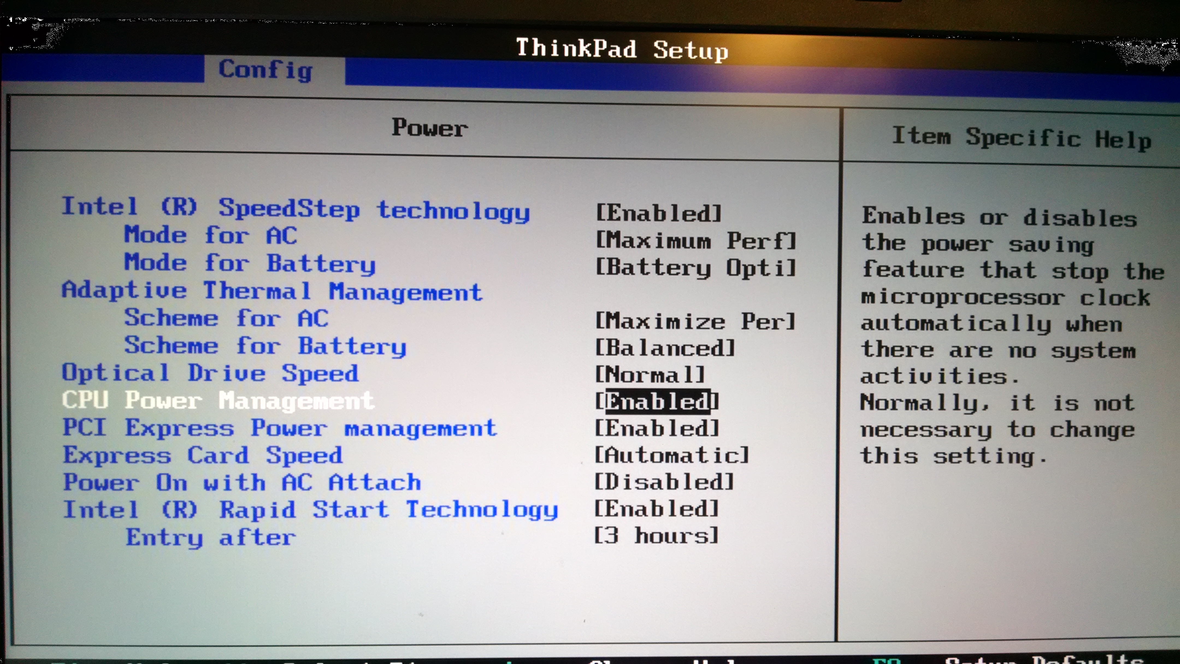
Power Management Settings
Hardware Power Management
Notes:
If CPU throttling is occurring, change power management setting main BIOS settings to either None or OS control.

Slide 4
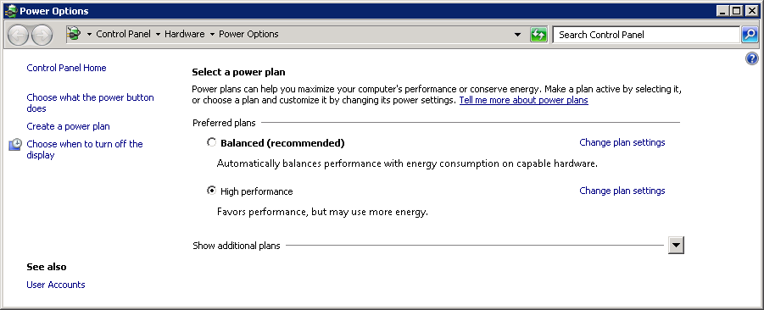
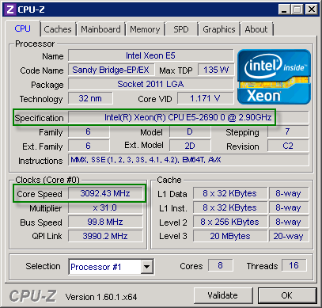
Power Management Settings
High Performance Power Option
Processor Core Throttling: CPU-Z
www.cpuid.com/softwares/cpu-z.html
Notes:
High Performance Power Option – change from default “Balanced” to “High Performance”
Processor Core Throttling – use CPU-Z to ensure CPU is operating at designed speed, i.e. not throttled back by hardware power mgmt.
www.cpuid.com/softwares/cpu-z.html

Slide 5

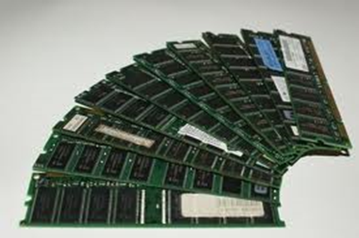

compute resources & performance
Storage
Memory
CPU

Slide 6

storage performance
Slowest compute resource, even with SSDs
SQL Server generates a mixed IO workload
- Random access for data files (*.mdf; *.ndf)
- Sequential access for transaction log files (*.ldf)
Whenever possible, avoid shared data access path and shared drives
Notes:
SAN Storage Best Practices for SQL Server: http://www.brentozar.com/sql/sql-server-san-best-practices/
SQL Server on a SAN: Dedicated or Shared Drives

Slide 7
storage performance
There is no one "best practice" here!
Variables - Spinning disks vs. SSDs - SAN vs. Direct Attached Storage - Type of SAN - Workload
Configure for Performance, not Capacity
Benchmark! (Storage Benchmarking with DiskSpd http://www.davidklee.net/2015/04/01/storage-benchmarking-with-diskspd/ )
Notes:
Variables - SAN vs. Direct Attached Storage
Direct Storage: separate data and log files
more, smaller drives in appropriate RAID configuration - Spinning disks vs. SSDs - Type of SAN – recommendations vary by vendor. Read the documentation - Workload – database workload and anything else on the shared drives
Configure for Performance – more smaller drives, proper RAID configuration
Benchmark utility: DiskSpd https://gallery.technet.microsoft.com/DiskSpd-a-robust-storage-6cd2f223
Using DiskSpd to Test Your Storage Subsystem - http://sqlperformance.com/2015/08/io-subsystem/diskspd-test-storage

Slide 8
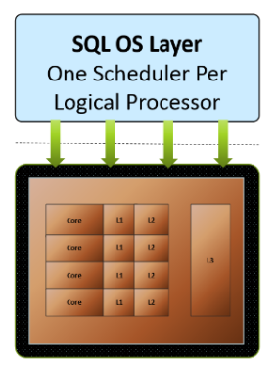
sqlos & cpu
Windows has no understanding of SQL Server resources
SQLOS creates a scheduler for each logical CPU
Only one worker is executed by a scheduler at the same time
Cooperative vs Preemptive scheduling
http://exadat.co.uk/2014/09/30/under-the-hood-with-sql-server-batch-mode-part-5memory-usage-nuances-at-cpu-level/
Notes:
NUMA – each NUMA node works with assigned address space. Often more efficient unless a lot of “cross over” is required
SQL Server assigns one Scheduler per core
A scheduler is a logical CPU for SQL Server worker threads
Cooperative scheduling –(quantum). Threads are expected to voluntarily yield to other threads waiting
Preemptive scheduling - thread stays on CPU for a defined duration, then is forced off if another thread is waiting
Running – thread is on cpu
Waiting – off CPU, waiting for a resource
Runnable – on the CPU queue
last 2 are where Wait Stats come into play

Slide 9
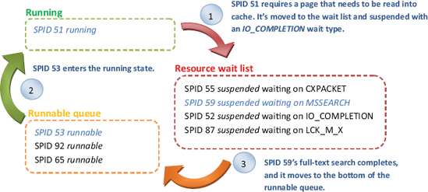
sqlos cpu scheduler
http://programming4.us/database/16508.aspx
Build my own version of this diagram??
Notes:
NUMA – each NUMA node works with assigned address space. Often more efficient unless a lot of “cross over” is required
SQL Server assigns one Scheduler per core
A scheduler is a logical CPU for SQL Server worker threads
Cooperative scheduling –(quantum). Threads are expected to voluntarily yield to other threads waiting
Preemptive scheduling - thread stays on CPU for a defined duration, then is forced off if another thread is waiting
Running – thread is on cpu
Waiting – off CPU, waiting for a resource
Runnable – on the CPU queue
last 2 are where Wait Stats come into play

Slide 10
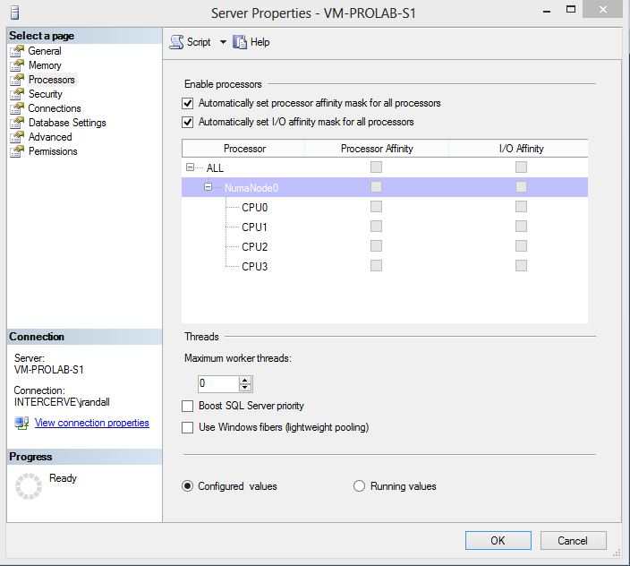
cpu impacting settings
max degree of parallelism
¼ to ½ of available cores
cost threshold for parallelism
change from default setting
affinity I/O mask
normally left at default (ALL)
Notes:
max degree of parallelism – limit # of processors used to process a query. Can be overridden using MAXDOP option
cost threshold for parallelism – threshold used by the query optimizer in determining whether it should consider parallel plans. Cost is a "score" calculated using a fixed price for the estimated number of times every operation in the plan is expected to take place. Query optimizer uses the costs of various plans to determine which one to use Setting to 1 disables parallelism.
affinity mask & affinity mask IO – map threads to cpu
Other
max worker threads – enables SQL Server to create a pool of threads. 0 means SQL Server will adjust the number as needed
On a 64 bit system the max_worker_threads value is calculated if the number of schedulers exceeds 4, otherwise
a base value of 512 is used. If you have more than 4 schedulers, then the value is ((NumSchedulers-4)*16) +512.
You can see the value for this in the sys.dm_os_sys_info DMV
msdn.microsoft.com/en-us/library/ms187024.aspx

Slide 11

sql server & memory
*
IMO the single most important hardware resource
SQL Server only works with data in memory
SQL Server has its own memory manager
Acquires memory as needed then holds it
*http://www.gizmag.com/memory-storage-theory/21900/
Notes:
When considering SQL Server performance, RAM is arguably your most important resource.
That does not mean an over abundance of RAM guarantees great performance
It does mean that too little memory almost always guarantees sub-optimal to miserable performance
All DML, and many SQL Server internal processes, are performed exclusively against data pages residing in memory – the SQL Server buffer cache. Furthermore, the plan cache(s) store query plans (ad hoc, autoparameterized, prepared) and object plans (procs, triggers, functions) for quick retrieval.
SQL Server Memory Manager - SQL Server manages movement of data between disk and memory using several mechanisms (memory manager, optimizer?, checkpoints, lazy writes, log flushes)
Using SQL Server 2008 – 2008 R2, make use of AWE to access memory above 4 GB, buffer cache only. No longer supported in SQL Server 2012.

Slide 12
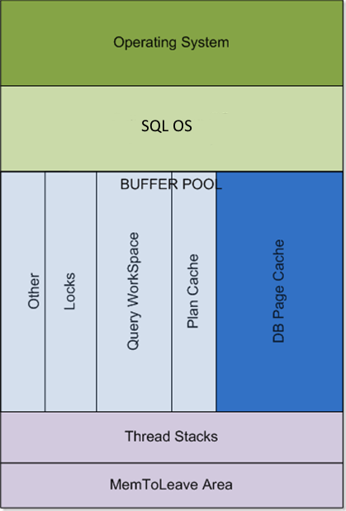
memory architecture
Notes:
Important concepts:
SQLOS manages SQL Server's internal memory usage
Data is stored in 8K pages. It is critical to understand that SQL Server manages data at the page level.
Data is moved between memory and disk by several processes including:
checkpoint
lazy writes
log flushes
query requirements

Slide 13
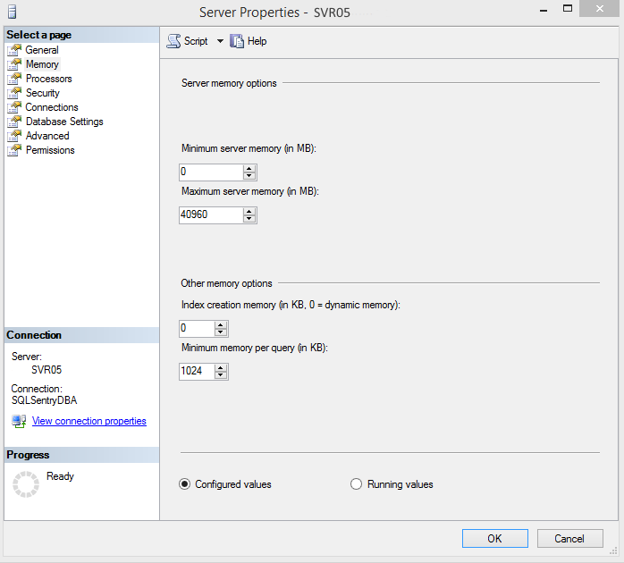
memory impacting settings
max server memory
ALWAYS change from default setting
min server memory
multi-instance & failover clusters
optimize for ad hoc workloads always enable
lock pages in memory
set in Local Group Policy Editor
Notes:
Lock Pages in Memory – prevents Windows from "stealing" memory from SQL Server

Slide 14
memory configuration
Max Server Memory Considerations
Total Physical Memory Available
What SQL Server components are installed & running (SSRS, SSIS, Full Text Search, etc.)
SQL Server version & edition differences
SQL Server Failover Cluster or multiple instances?
Other applications
Notes:
What should you set max server memory to?
Calculate Max Server Memory
Non-clustered, single instance
Basic: reserve 2 GB for OS + memory requirements non-SQL Server apps
Alternative (J. Kehayias): reserve at least 1 GB (usually 2 GB) for OS + 1 GB for every additional 4 GB of RAM up to 16 GB + 1 GB for every additional 8 GB of RAM over 16 GB
Examples: Physical RAM = 8 GB, max server memory = 5 GB Physical RAM = 24 GB, max server memory = 18 GB
Clustered instances
Same numbers as above divided by the number of nodes in the cluster

Slide 15
calculate max server memory
Non-clustered, single instance
Basic: reserve 2 GB for OS + memory requirements non-SQL Server apps
Alternative (J. Kehayias): reserve at least 1 GB (usually 2 GB) for OS + 1 GB for every additional 4 GB of RAM up to 16 GB + 1 GB for every additional 8 GB of RAM over 16 GB
Examples: Physical RAM = 8 GB, max server memory = 5 GB Physical RAM = 24 GB, max server memory = 18 GB
Clustered instances
Same numbers as above divided by the number of nodes in the cluster
Notes:
What should you set max server memory to?
Calculate Max Server Memory
Non-clustered, single instance
Basic: reserve 2 GB for OS + memory requirements non-SQL Server apps
Alternative (J. Kehayias): reserve at least 1 GB (usually 2 GB) for OS + 1 GB for every additional 4 GB of RAM up to 16 GB + 1 GB for every additional 8 GB of RAM over 16 GB
Examples: Physical RAM = 8 GB, max server memory = 5 GB Physical RAM = 24 GB, max server memory = 18 GB
Clustered instances
Same numbers as above divided by the number of nodes in the cluster

Slide 16
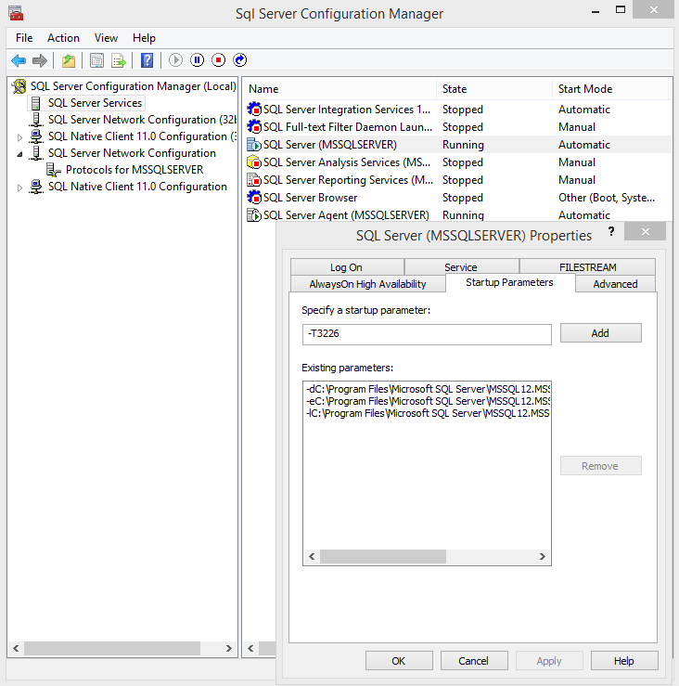
SQL Server Trace Flags
Include in SQL Server Startup Parameters
3226: suppress successful db backup msgs
1118: reduce tempdb allocation contention
Notes:
3226 – By Default, SQL Server writes a message in the SQL Server error log and system event log for every successful backup.
Seems like a nice, friendly thing to do right? Drop a note that your backup was successful, note the LSN, etc.
When you do a LOT of backups the errorlog very quickly gets bloated with success messages. This in turn causes two issues:
Managing the size of the log itself
Finding anything actionable in the flood of success messages.
traceflag 3226 suppresses these success messages from both the SQL errorlog and the system event log.
1118: switches allocations in tempdb from single-page at a time for the first 8 pages, to immediately allocate an extent (8 pages).
It’s used to help alleviate allocation bitmap contention in tempdb under a heavy load of small temp table creation and deletion.
http://www.sqlskills.com/blogs/paul/misconceptions-around-tf-1118/
Using SQL Server Configuration Manager
To configure startup options
In SQL Server Configuration Manager, click SQL Server Services.
In the right pane, right-click SQL Server (<instance_name>), and then click Properties.
On the Startup Parameters tab, in the Specify a startup parameter box, type the parameter, and then click Add.
For example, to start in single-user mode, type -m in the Specify a startup parameter box and then click Add. (When you restart SQL Server in single-user mode, stop the SQL Server Agent. Otherwise, SQL Server Agent might connect first and prevent you from connecting as a second user.)
Click OK.
Restart the Database Engine.

Slide 17
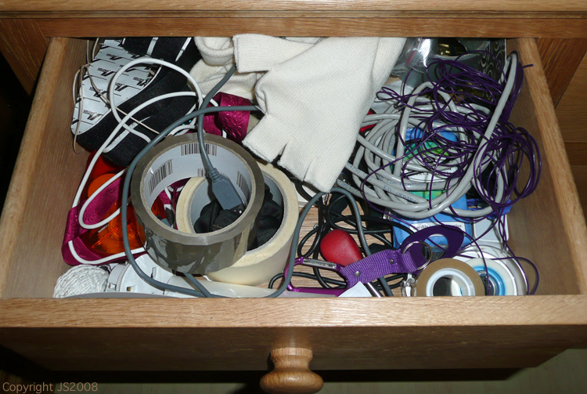
tempdb
SQL Server's junk drawer
http://www.thedeppeffect.com/467/abc-wednesday-the-letter-j/

Slide 18
what goes in tempdb?
User created objects from all user databases mostly temp tables and table variables
Internal temporary objects work space for queries intermediate result sets, worktables, sorts index rebuild and other operations when "sort in tempdb" is on
References: Working with tempdb in SQL Server 2005
https://technet.microsoft.com/library/Cc966545#EGAA
Understanding TempDB, table variables v. temp tables and Improving throughput…
http://bit.ly/1CSL6CH

Slide 19
Tempdb Contention
Potential Major Performance Bottleneck
Shared Resource: 1 per SQL Server instance!
Action Items:
Isolate files from all other user databases
Manage I/O Contention
Right Size, set Autogrow to MB not %
Notes:
Isolate files from all other user databases Rebuilt on every SQL Server restart - often a good candidate for SSDs
I/O Contention Usually resolved using multiple data files, one log file.
Add Trace Flag 1118 to startup parameters
Sizing
all data files must be same size
total size should be set to eliminate auto grow events

Slide 20
virtualization considerations
Key: Properly Distributed Workload
Do not share resources with other applications
Separate SQL Server disks from other workloads
Benchmark SQL Server Workload

Slide 21
virtualization considerations
Additionally…
Turn off Memory Ballooning
Don't over allocate CPUs
Do not enable CPU Hot Add
Use Virtual Disks

Slide 22

Database Configuration
Rules of Thumb
Enable Instant File Initialization
Separate data files from log files
Plan for growth when creating db files
Set AutoGrow to fixed MB, not %
Set Tlog file size & AutoGrow to reduce fragmentation
Set AutoClose OFF!!!

Slide 23

Database maintenance
The Necessities
Appropriate backup schedule for recovery requirements
validate backups with periodic restore operations
DBCC CHECKDB
Index maintenance
Statistics maintenance

Slide 24
performance checklist 1
Set Power Management settings
Enable Instant File Initialization
Optimize Disk Layout
Allocate sufficient memory
Add Trace Flags
Adjust SQL Server CPU related settings

Slide 25
performance checklist 2
Adjust SQL Server Memory related settings
Optimize TempDB configuration
VM Configuration
avoid memory ballooning and cpu over-allocation
Check Database Configuration file size and location, autogrow in mb, autoclose off
Automate Database Maintenance

Slide 26
Resources
SQL Server Books Online http://msdn.microsoft.com/en-us/library/ms130214(v=sql.105).aspx
SQL Server Hardware – Glenn Berry http://www.amazon.com/SQL-Server-Hardware-Glenn-Berry/dp/1906434638
SQL Server Diagnostic Queries – Glenn Berry http://sqlserverperformance.wordpress.com/category/diagnostic-queries/
Provisioning a New SQL Server Instance - Glenn Berry https://www.simple-talk.com/sql/database-administration/provisioning-a-new-sql-server-instance-–-part-one https://www.simple-talk.com/sql/database-administration/provisioning-a-new-sql-server-instance-–-part-two
How and Why to Enable Instant File Initialization http://blogs.msdn.com/b/sql_pfe_blog/archive/2009/12/23/how-and-why-to-enable-instant-file-initialization.aspx

Slide 27
Resources
SAN Storage Best Practices for SQL Server http://www.brentozar.com/sql/sql-server-san-best-practices/
Understanding TempDB, table variables v. temp tables… http://www.sqlskills.com/blogs/kimberly/understanding-tempdb-table-variables-v-temp-tables-and-improving-throughput-for-tempdb/
Working with tempdb in SQL Server 2005 https://technet.microsoft.com/library/Cc966545#EGAA
Troubleshooting SQL Server – A Guide for the Accidental DBA Jonathan Kehayias - http://www.amazon.com/dp/1906434786
The Top 5 Most Common SQL Server Performance Problems – Jason Hall http://www.sqlperformance.com/2012/08/t-sql-queries/5-common-performance-problems

Slide 28
shameless plug
Engage with our community: Facebook: https://www.facebook.com/SQLSentry?fref=ts Twitter: @SQL_Sentry Website: http://SQLSentry.com
Share your tough SQL Server performance problems with us: http://answers.sqlperformance.com
Expert SQL Server Performance Tips: http://www.sqlperformance.com
Engage our Professional Services Group: http://www.sqlsentry.com/#services
Download SQL Sentry Plan Explorer for free: http://www.sqlsentry.com/products/plan-explorer/sql-server-query-view

